Slide 1
FAKE NEWS CLASSIFIER PROJECT
Utkarsha A Jadhav

Slide 2
ABOUT Fake news
Fake news is false or misleading information presented as news. It often has the aim of damaging the reputation of a person or entity, or making money through advertising revenue. However, the term does not have a fixed definition, and has been applied more broadly to include any type of false information, including unintentional and unconscious mechanisms, and also by high-profile individuals to apply to any news unfavorable to his/her personal perspectives.

Slide 3
PROBLEM
introduction
Problem analysis introduction, conceptual background and review of literature.
Analytical problem Framing
Mathematical/ Analytical Modeling of the Problem, Data Sources and their formats.
Insights and model development
EDA, Word cloud, Training the model
Conclusion
Key Findings, learning outcome, limitation of the work.

Slide 4
SOLUTION
Understanding the Business requirements
EDA
We have done reasonable analysis with the data collected and figured out news without author name are tend to be more fake than other
Done basic data cleansing and play around with the data and preprocessing.
Insights
Plotting the model with NLP
With use of word cloud we are analyzing the data
With all above collected and preprocessed data using ML we are creating a model.

Slide 5
Conceptual Background of the Domain Problem
The authenticity of Information has become a longstanding issue affecting businesses and society, both for printed and digital media. On social networks, the reach and effects of information spread occur at such a fast pace and so amplified that distorted, inaccurate, or false information acquires a tremendous potential to cause real-world impacts, within minutes, for millions of users. Recently, several public concerns about this problem and some approaches to mitigate the problem were expressed
In the below blog we are going to see about how we are classifying the fake news with the genuine news; we are going to use several machine learning techniques and we will plot and analyse how to identify a news as fake. I have tried using several NLP techniques and arrived at a model that will classify news is fake or genuine.

Slide 6
Review of Literature
The purpose of the literature review is to:
Identify the News basis on the content and author to tell weather it is fake or not.
Stop the spread of fake news which will potentially spread incorrect information amount the people.

Slide 7
Analytical Problem Framing

Slide 8
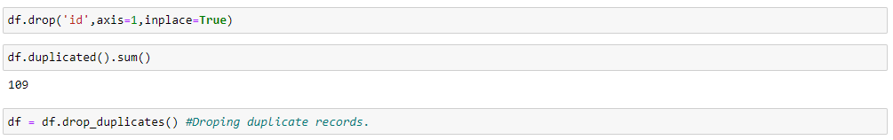
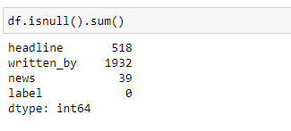
Mathematical/ Analytical Modeling of the Problem
I start analysis on this project in importing the data set and simple play around with the data and identifying the characteristics of each column. I noticed that there are four columns “id”, “headlines”, “written_by”, “news”, “labels”. Id column only have unique variables which won’t help us in predicting.so I decided to drop ID. And I also checked there were about 109 duplicate records I dropped those records also.
Then post this I analysed the label column which is our target variable and I understood that label column has two variables ‘0’ and ‘1’. ‘0’denotes not a fake news and 1 denotes fake news.

Slide 9
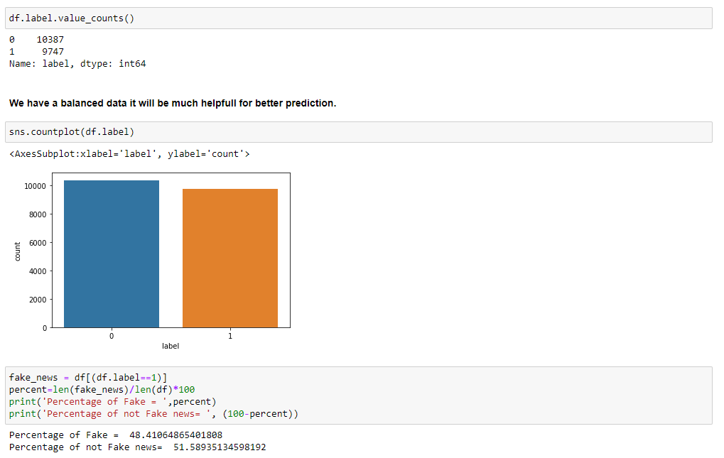
Mathematical/ Analytical Modeling of the Problem
On further analysis of the label data, I understood that we have a balanced data almost 50% of data with fake news and not fake news. Balance data will help us in building a perfect machine learning model and we also avoid the model to overfit and underfit with the data.

Slide 10
Data Source and formats.
Data Sources and their formats
There are 6 columns in the dataset. The description of each of the column is given below:
“id”: Unique id of each news article
“headline”: It is the title of the news.
“news”: It contains the full text of the news article
“Unnamed:0”: It is a serial number
“written_by”: It represents the author of the news article
“label”: It tells whether the news is fake (1) or not fake (0).

Slide 11
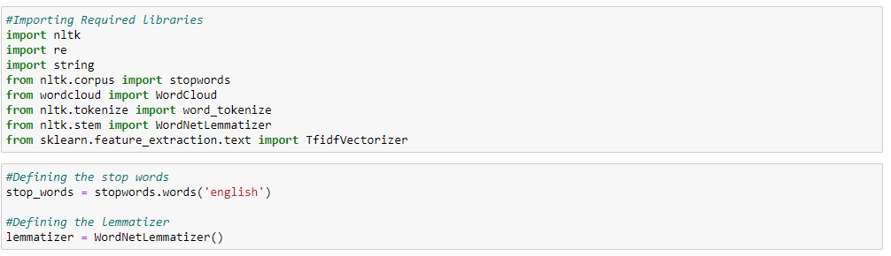
Data Pre-Processing.
I started the pre-processing with cleansing the data, filtering out all the Bash data and I like to keep only the required data for our analysis.
I started with importing the required libraries. And I have declared stop words and lemmatize to a variable

Slide 12
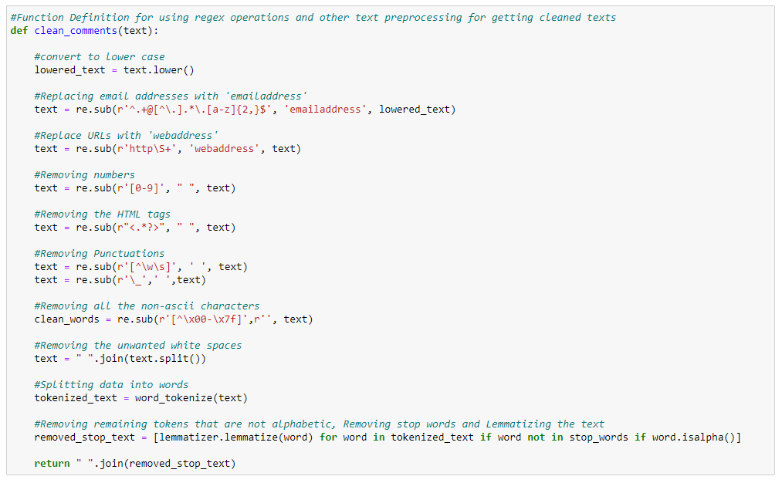
Data Pre-Processing.
Then I have created a function to clean the data as like below.

Slide 13
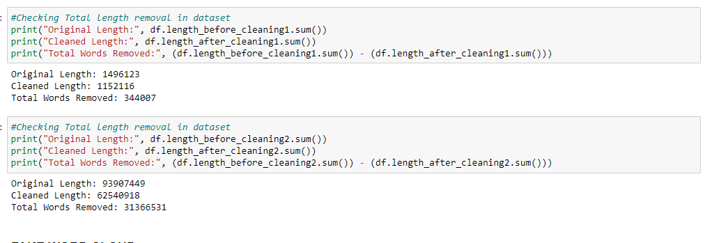
Data Pre-Processing.
To understand how much data, I have removed I calculated with the length of the column before cleansing and I calculated length of the columns after cleansing

Slide 14
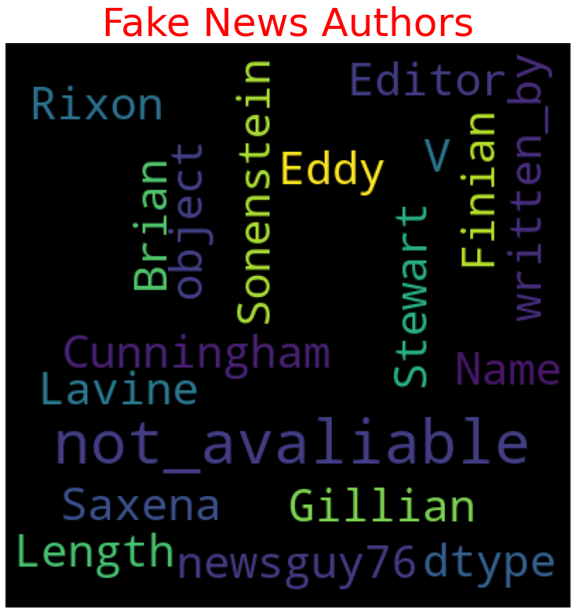
Insights with word cloud
Key Observations:
We can evidently see that most of the fake news are from "not_avaliable", "Dtype', "Length", "Editor" which means these fake news sources are not available.
News without a proper author name is being a fake news.

Slide 15
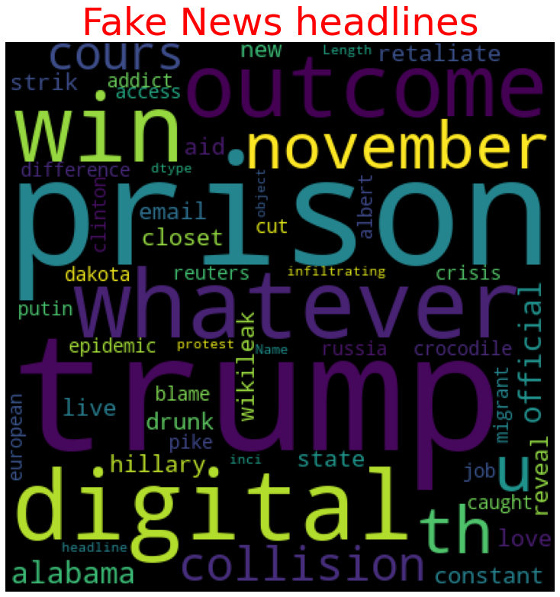
Insights with word cloud
Key Observations:
Fake news headlines have most repeated keywords Trump, Prison, win outcome November. So, any news on these keywords might be fake.
This data should be taken at the time of election or before the time of election because we link the key words, we can understand these news’s are fake propaganda.

Slide 16
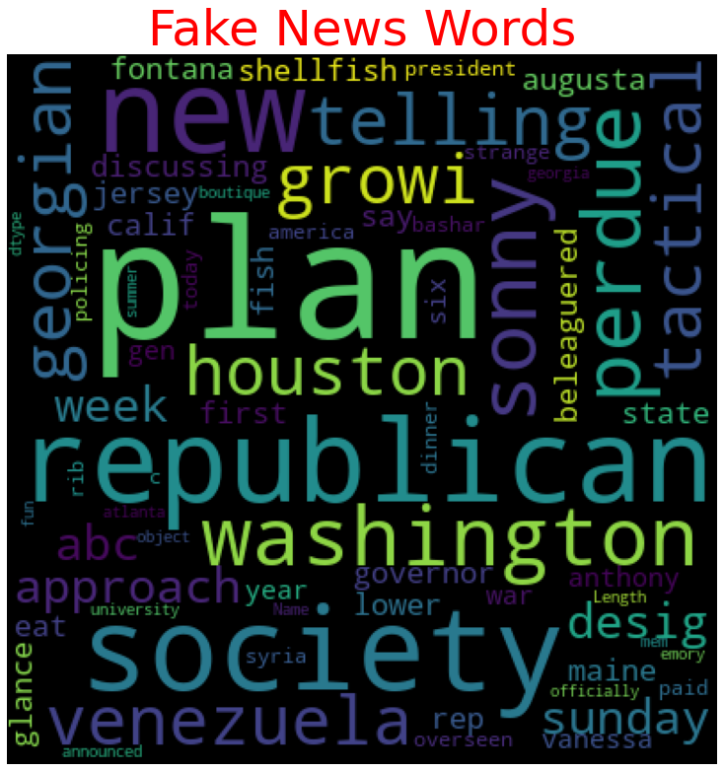
Insights with word cloud
Key Observations:
Fake news’s has most repeated keywords Washington, republican, plan, Society so any news on these keywords might be fake
As live we guessed before there are more chances that this data might have taken before the time of election or might be some funded individuals might have speeded this news’s.

Slide 17
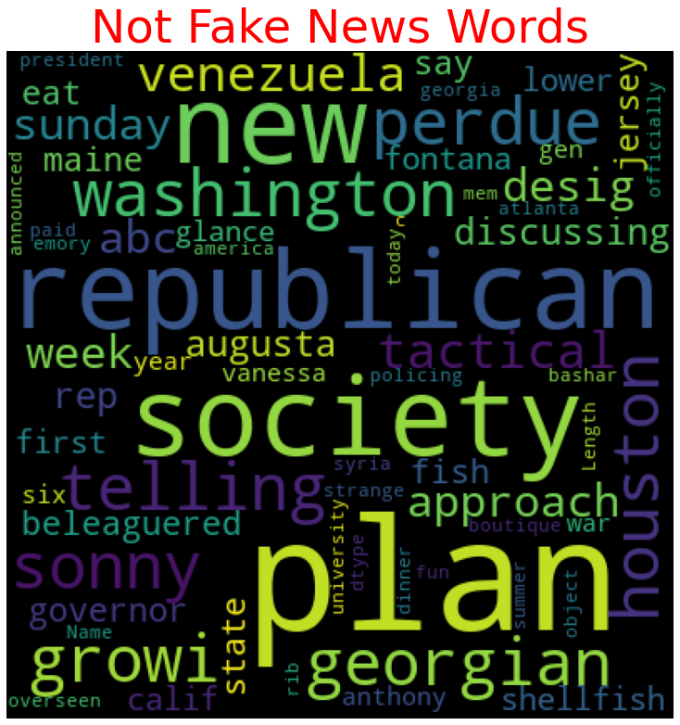
Insights with word cloud
Key Observations:
Not Fake news have most repeated keywords Washington, republican, plan, Society which are as same as repeated words in fake new. So, news won’t be much helpfully in our prediction.
And we also see week, Augusta, sonny, telling, Georgian are being the most repeated words in not Fake news.

Slide 18
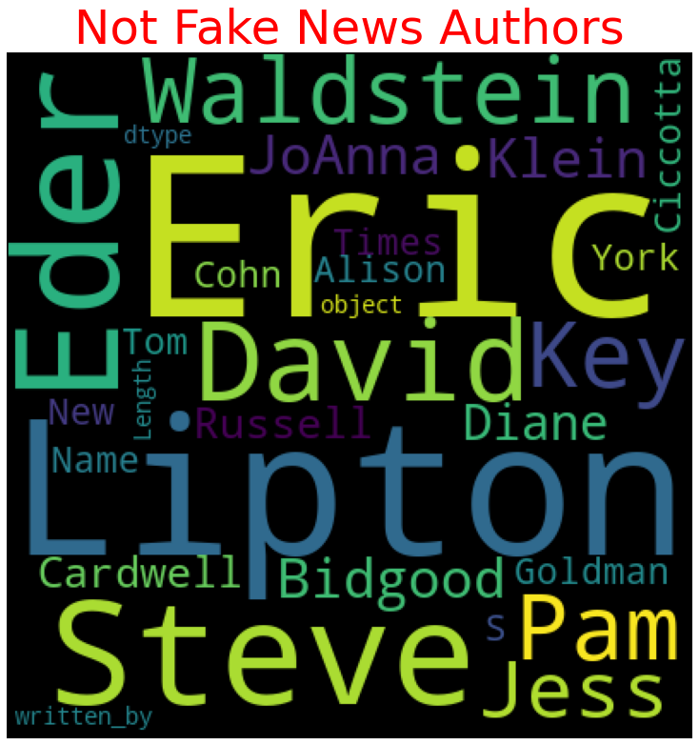
Insights with word cloud
Key Observations:
In Not Fake news we can see many authors, which is a clear indication that if author names are available that possibility of being not fake is high.
We can see and compare with the fake news authors that there are no bogus names here. And also, our imputed name not_avaliable is also not in this list

Slide 19
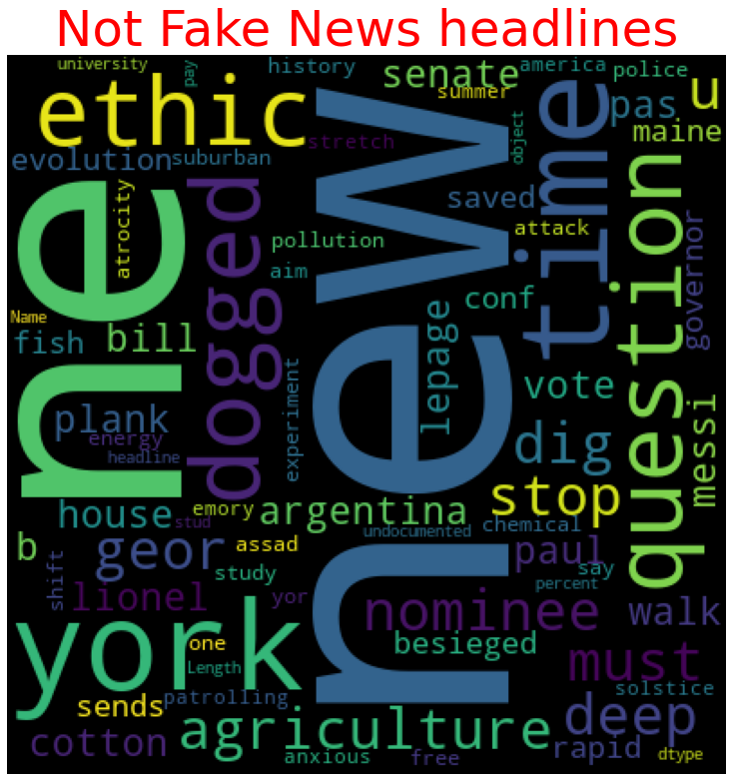
Insights with word cloud
Key Observations:
In not fake headlines we can see New, ethic, time, culture, question, agriculture, York.
We will use written by and headlines in our model building.
And we can clearly notice the headlines difference from the fake headlines and there no words matching with fake headlines.

Slide 20
Hardware and software requirements.
Python 3.8.
NumPy.
Pandas.
Matplotlib.
Seaborn. 6. Data science.
SciPy
Sklearn.
Anaconda Environment, Jupyter Notebook.

Slide 21
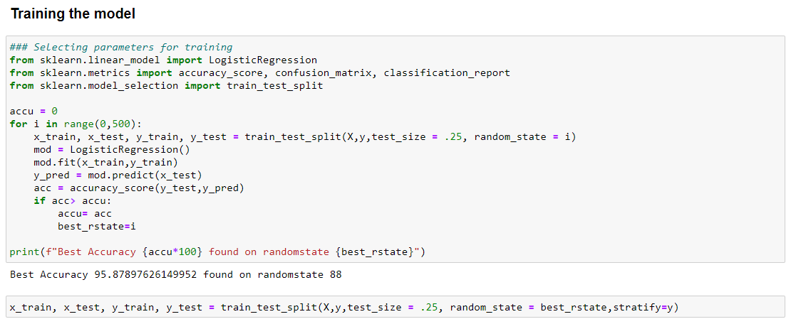
Model Development.
I have started the training in selecting the best random state parameter for the model as follows.

Slide 22
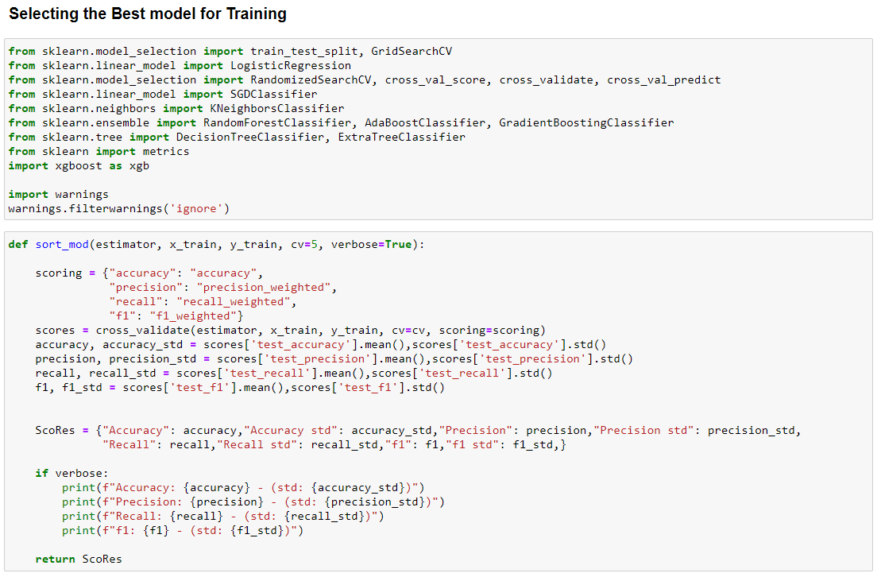
Model Development.
After selecting the best random state parameter, I have spitted the data into test and train with test size as 25 %. Again, I have imported the required libraries to import my ML algorithms.

Slide 23
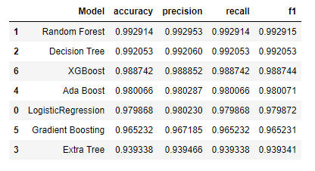
Key-Metrics for success in solving problem under consideration.
I have taken key metrics as Accuracy, Precision, Recall and F1 scores to analysis the best model.
As we can see above Random Forest tops the chart, I have selected Random Forest model as my final model and I have Hyper parameter tuned the same to increase the performance of the model and have achieved the accuracy of 99.364 % and I have saved the model.

Slide 24
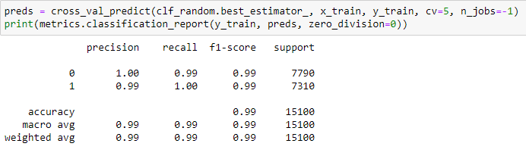
Key-Metrics for success in solving problem under consideration.
As we can see above Random Forest tops the chart, I have selected Random Forest model as my final model and I have Hyper parameter tuned the same to increase the performance of the model and have achieved the accuracy of 99.364 % and I have saved the model

Slide 25
SUMMARY
Key Findings and Conclusions of the Study
The finding of the study is that when the news’s are being published on a bogus name, the author names not available that news are end up being Fake, and also, we can understand this fake news’s are desperately being spread among the public to create a fake image of an individual, or to get profit out of it or to destroy the good deeds of the target person.

Slide 26
THANK YOU

